Slide 1
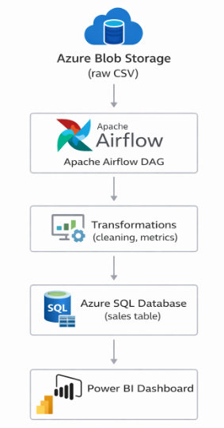
Sales Analytics ETL Project
End-to-End ETL Pipeline
• Apache Airflow for orchestration
• Azure Blob Storage as data source
• Azure SQL Database as data warehouse
• Power BI for analytics and visualization

Slide 2
ETL Architecture
Extract:
• CSV files ingested from Azure Blob Storage
Transform:
• Data validation and type casting
• Revenue calculation and business rules
Load:
• Cleaned data stored in Azure SQL Database
• automated using Airflow DAGs

Slide 3
Analytics & Business Insights
• Power BI dashboard connected to Azure SQL
• KPIs: Total Revenue, Orders, Quantity, AOV
• Trend analysis by date and category
• Scalable for star schema & incremental loads

